Slide 1



Data review

Slide 2
Data review
Validation
data warning and errors
conflict resolution
Using filters and optical analysis
Re-survey sample areas

Slide 3
Validation
Before uploading, JOSM will notify you of found errors/warnings.
READ, AND UNDERSTAND, THEM!
Then: 1) fix them, or 2) request help.

Slide 4
Conflict resolution
Best option: avoid conflicts: upload data often, in small portions
(at least once every 15 minutes!)
If a conflict happens while uploading:
Find the person whose data you’re conflicting with
Figure out what’s happening
In short, TALK

Slide 5
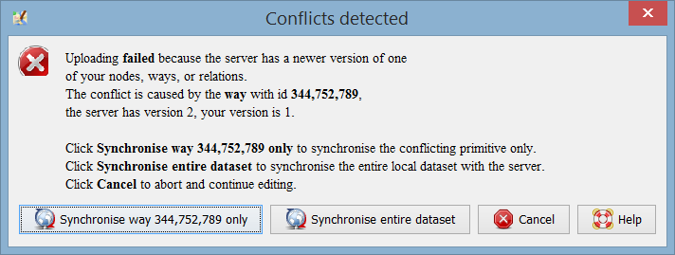
Conflict resolution
Be conservative! When given the choice, and you’re not sure, choose the other party’s data (which is already on the server)

Slide 6
Filters and optical analysis
Spotting common mistakes
Using filters

Slide 7
Optical analysis
Look at the map closely…
Are there any double buildings?
Footways that don’t connect to roads?
Things with a name that should be in another key (trees, buildings, etc)
Secondary/tertiary ways that don’t connect to a road network?
Strangely shaped buildings?
Crossing roads without a node to connect them?
Overlapping building?
Untagged ways?

Slide 8
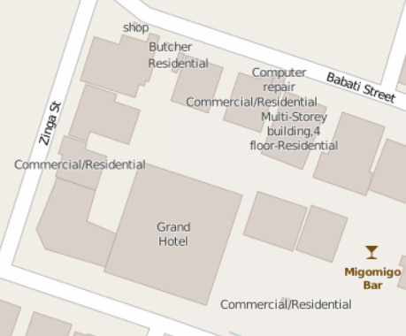
Common mistakes: ‘name’ tag
Using the “name” tag when it shouldn’t
(here, “building=type”, “amenity=service” and “building:levels=4”)

Slide 9
Names and capitalization
Good:
DJ Mrisho Records, Rama Garage, Feti Cafe
Bad:
DJ MRISHO records, MUSIC SHOP, Peace and love Pub, Feti cafe

Slide 10
Names and capitalization
Good:
Pongwe Road, Kondoa Street, Zinga Road
Bad:
Mufindi street, kikwetu street
Avoid:
Abbreviations like Mt., St., Str for Street

Slide 11
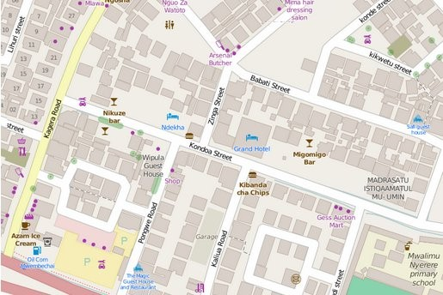
Names and capitalization

Slide 12
Common mistakes: mapping trees
Good:
species:en=coconut
Bad:
name=Coconut Tree

Slide 13
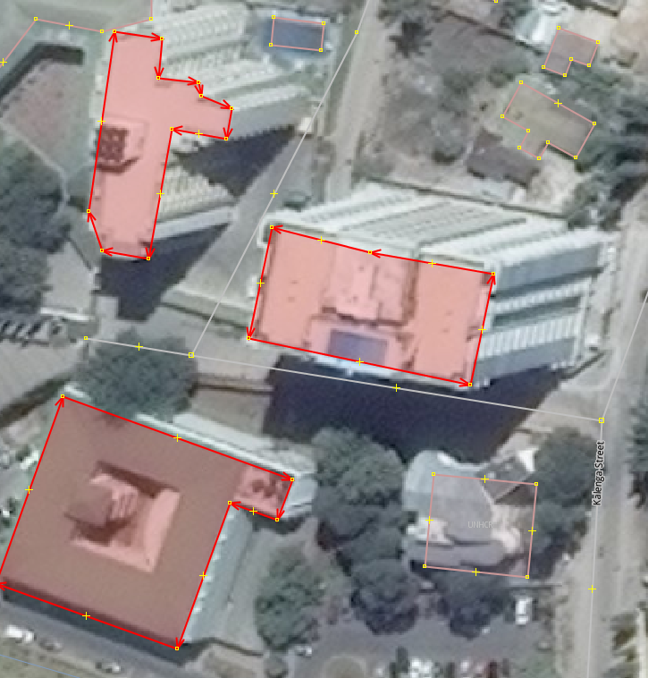
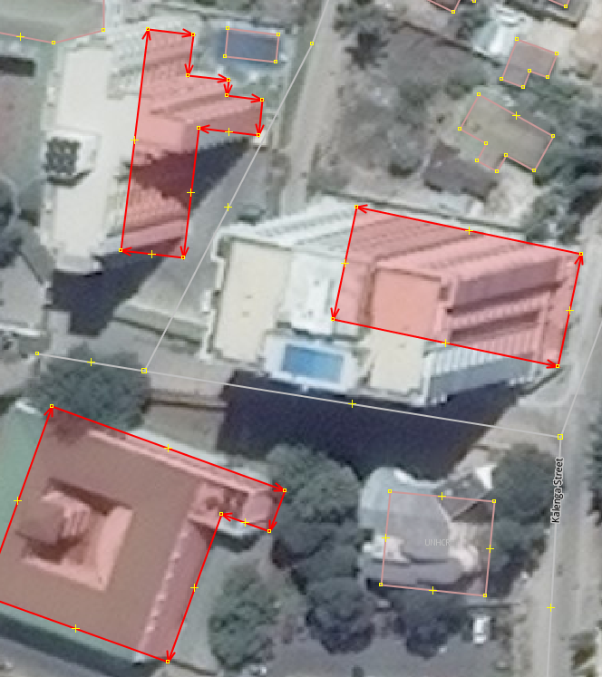
Common mistakes: top of building
Wrong: Correct:

Slide 14
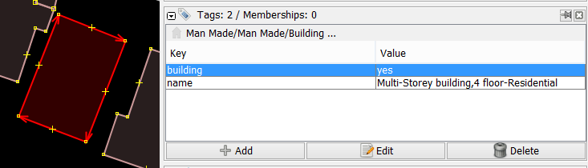
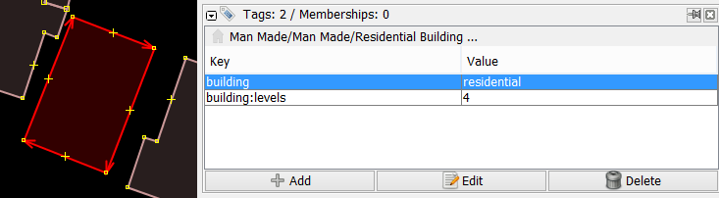
Building=yes, no levels, should not have a name

Slide 15
Filters
Filter | Purpose
waterway=* | natural=wetland | Focus on the drainage network, very useful for targeted analysis.
highway=* | Focus on the road network, very useful for targeted analysis.
building=* | Focus on the buildings.
building=* & (-building\:levels | -building\:material) | Find any buildings that don’t have either the ‘building:levels’ or the ‘building:material’ tag.
building=* & addr\:housenumber & -addr\:street | Find any buildings that have a house number, but lack a street name.

Slide 16
Filters (2)
Filter | Purpose
building=* & type:node | Find nodes that are tagged as building; this sometimes occurs due to uncareful selection.
natural=tree & name=* | Trees with a name. Most of the times, this should be put into ‘species:en’.
width:[A-Za-z] | height:[A-Za-z] | diameter:[A-Za-z] | Find any ‘width’, ‘height’ or ‘diameter’ attribute that has letters in it, often a unit. This was a common mistake in the first weeks.
timestamp:2015-04-15/ timestamp:2015-04-01/2015-04-12 | Focus only on the data for a particular day (or the defined timeframe)

Slide 17
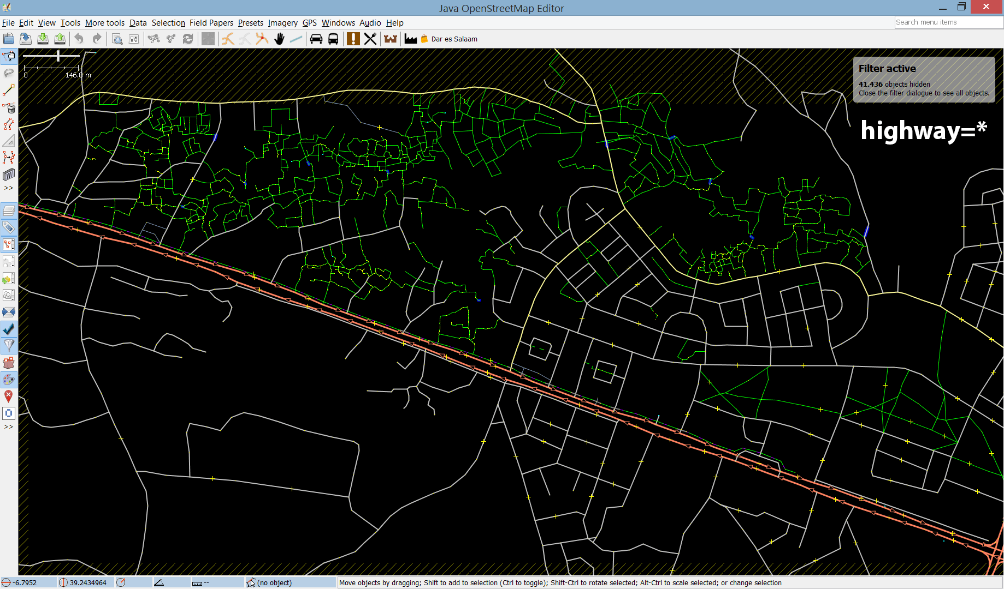
Gaps in the road network?

Slide 18
Gaps in the road network?

Slide 19
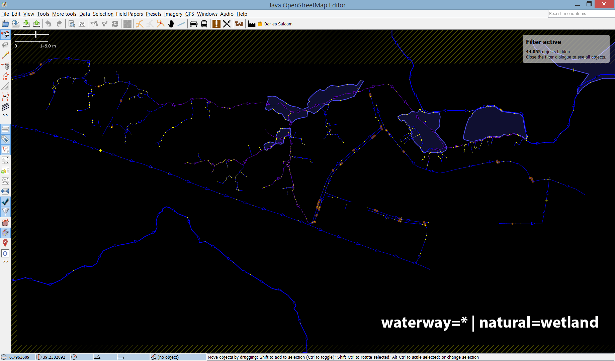
Gaps in the drainage network?

Slide 20
Gaps in the drainage network?

Slide 21
Re-survey sample area
Pick a small part area (say, 100x100 meters)
Go out to recollect data
Compare collected data with OSM data
Fix tagging mistakes
Fix missing/incomplete/wrong data
Takes notes of the found mistakes, and submit to supervisor

